Slide 1

Skin Lesion Analyzer
Santosh Kumar
M.Tech (CSE)

Slide 2
Content
Introduction
Objective
Business Problem
Propose Solution
Outcome
Conclusion
References

Slide 3
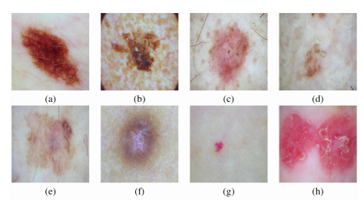
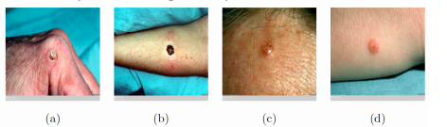
Introduction
Skin diseases are more common than other diseases. It may be caused by fungal infection, bacteria, allergy, or viruses, etc.
A disease may change texture or color of the skin.
In general, skin diseases are chronic, infectious and sometimes may develop into skin cancer.
Fig. 1. Types of Dermoscopic skin lesions where (a) Nevi
(b) Melanoma (c) Basal Cell Carcinoma (d) Actinic Keratosis (e) Benign
Keratosis (f) Dermatofibroma (g) Vascular Lesion (h) Squamous Cell
Carcinoma
Types of clinical skin lesions where
(a) Benign Keratosis (b) Melanoma (c) BCC (d) SCC

Slide 4
Objective
Suggest highest probability diagnoses for a given skin lesion image.
Recommend possible tips and treatment for medicine.

Slide 5
Business problem
Design & develop Artificial Intelligence (AI) enabled computer-aided diagnostics(CAD) solutions for the diagnosis of skin cancer. With the increasing incidence of skin cancers, low awareness among a growing population, and a lack of adequate clinical expertise and services, there is an immediate need for AI systems to assist clinicians in this domain.

Slide 6
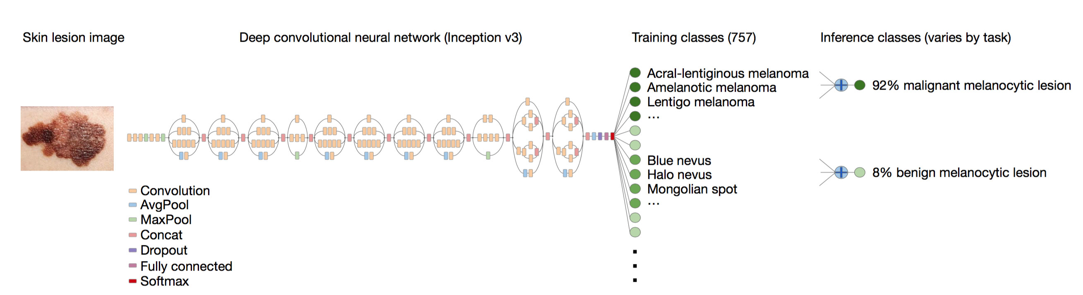
Propose Solution
AI-enabled computer-aided diagnostics (CAD) solutions are poised to revolutionize medicine and health care, especially in medical imaging.
Deep learning has provided various end-to-end solutions in the detection of abnormalities such as breast cancer, brain tumors, lung cancer, esophageal cancer, skin lesions, and foot ulcers across multiple image modalities of medical imaging

Slide 7
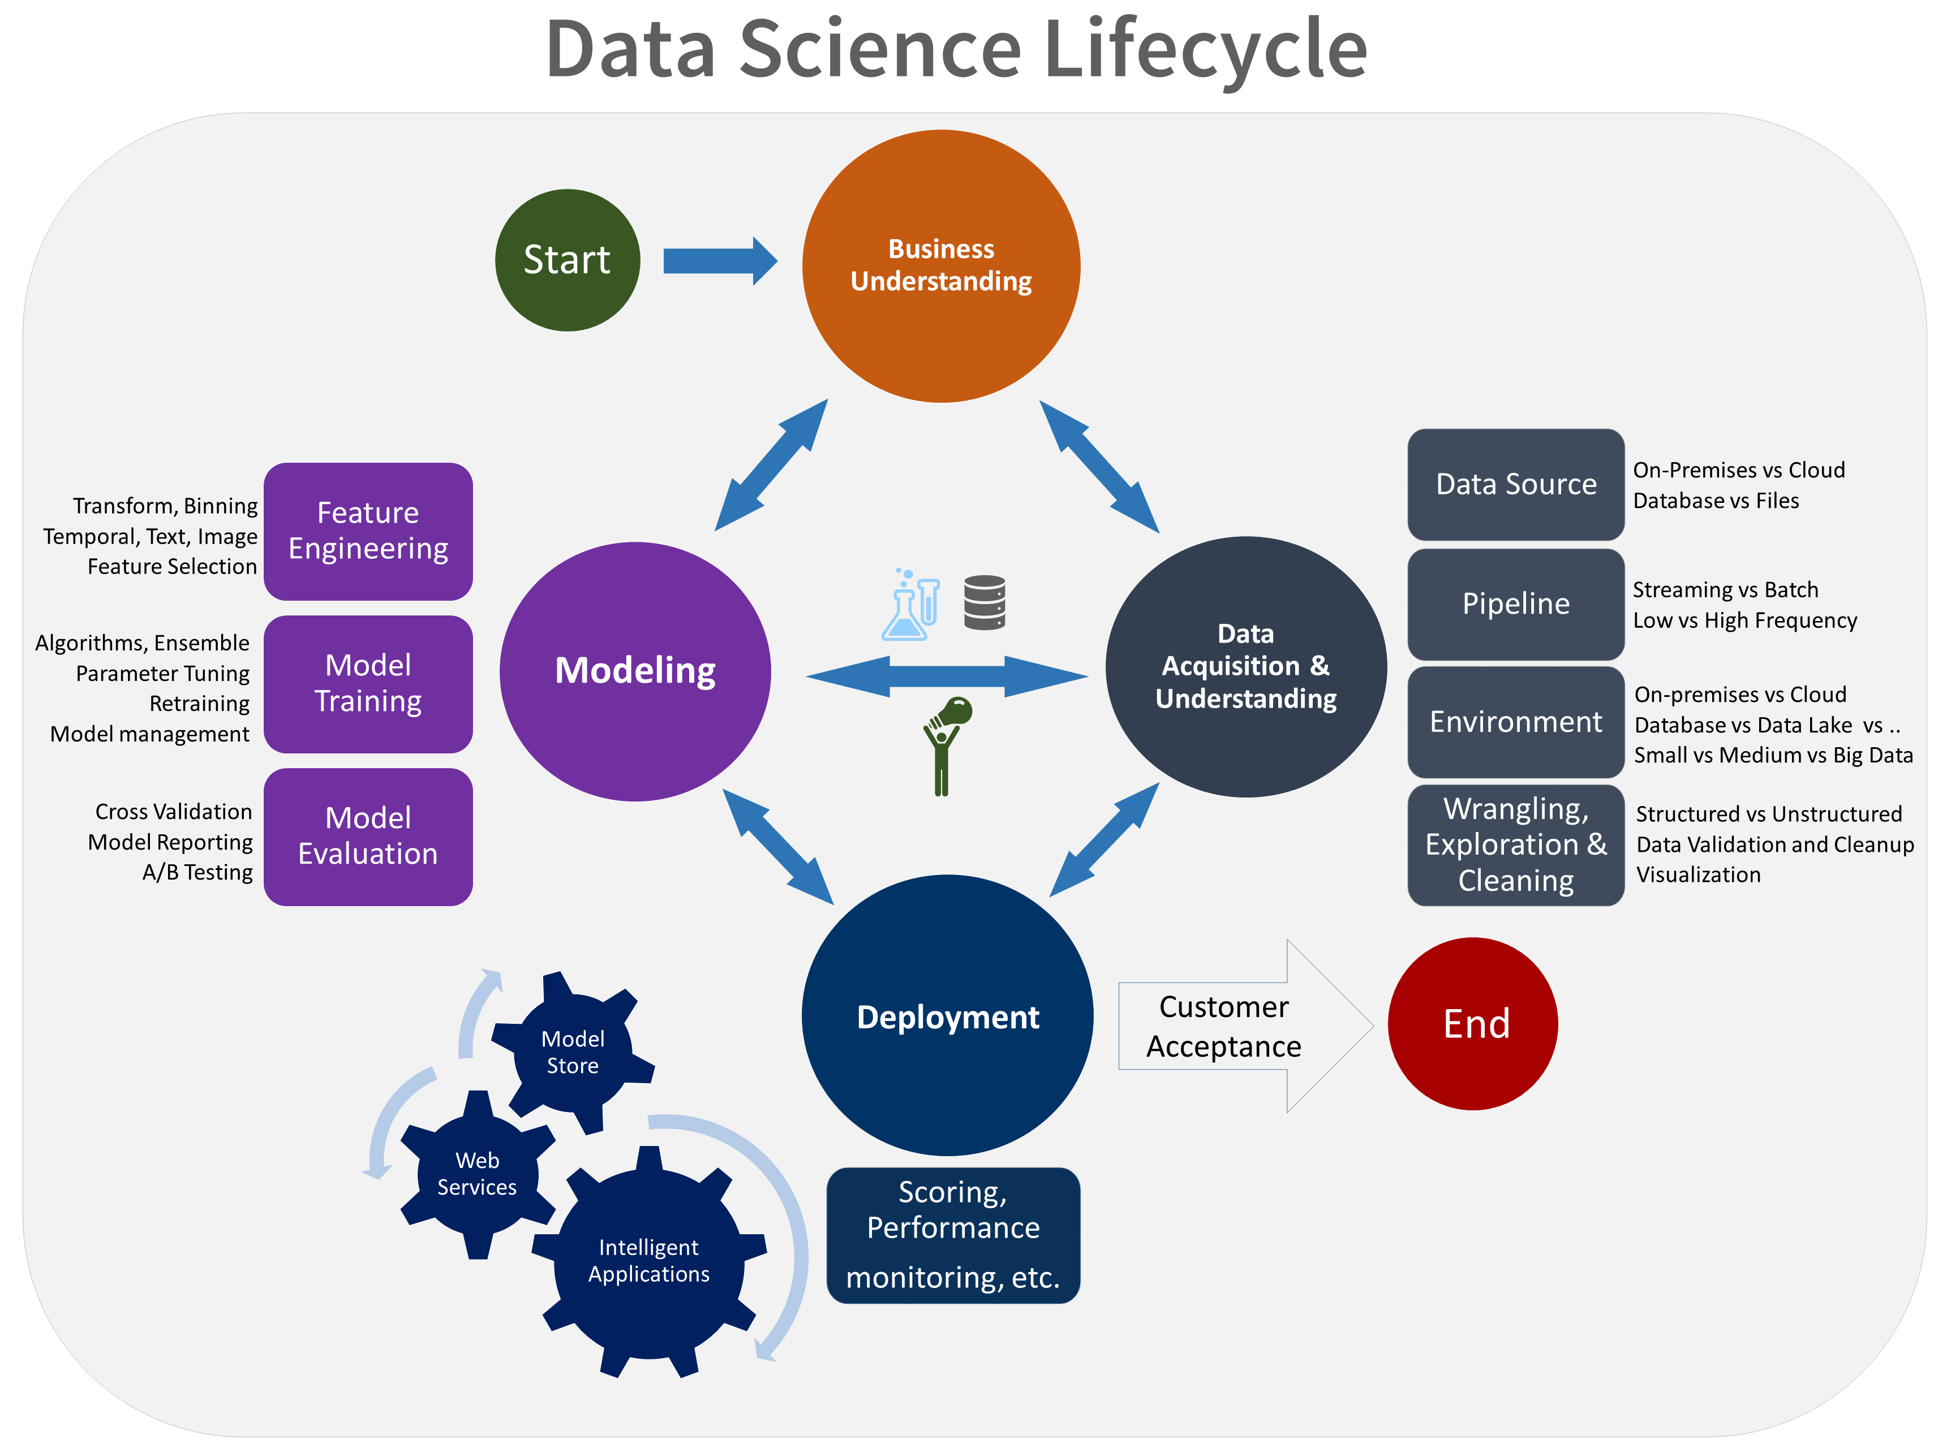
Life Cycle of DS USE CASE

Slide 8
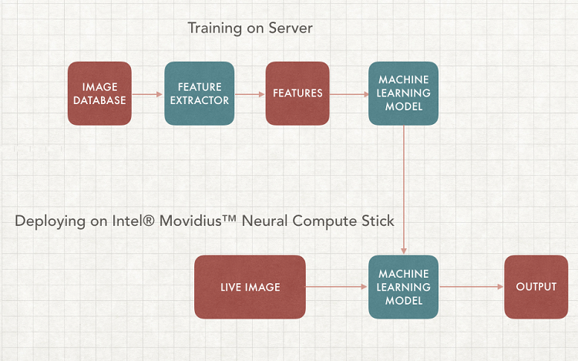
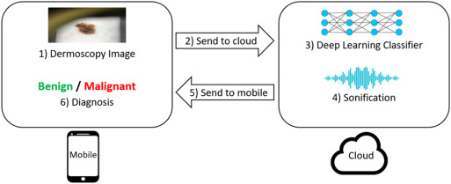
System Architecture
Fig- 2 System overview
Fig- 3 Workflow of model on server as well as client

Slide 9
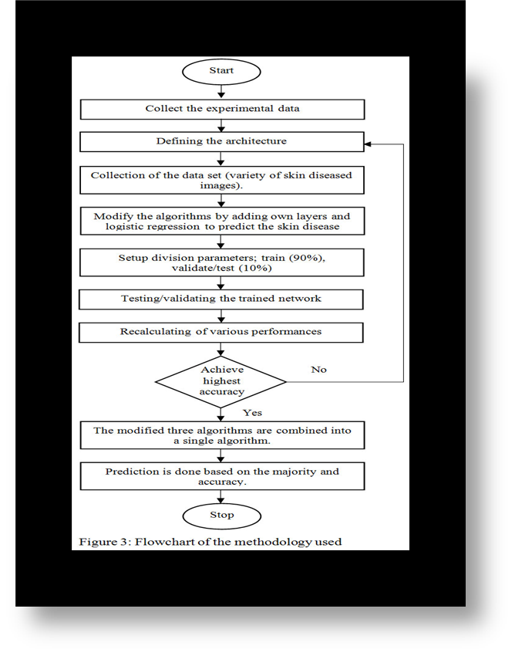
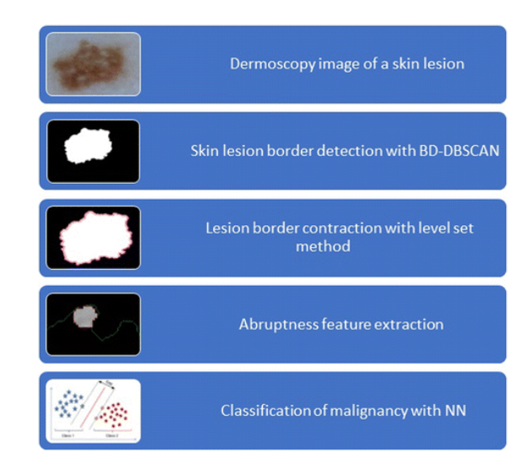
operations on skin images
Fig 4 Global Work flow

Slide 10
Outcome / Result
Classes of Skin lesion
'akiec, Actinic Keratoses (Solar Keratoses) or intraepithelial Carcinoma (Bowen’s disease)’,
'bcc, Basal Cell Carcinoma’,
'bkl, Benign Keratosis’,
'df, Dermatofibroma’,
'mel, Melanoma’,
'nv, Melanocytic Nevi’,
'vasc, Vascular skin lesion'
Selection of Image from local Computer/ Mobile
Probability of target class (Skin Disease)
** Here classify the seven classes of disease

Slide 11
Sample Outcome

Slide 12
requirement
Image dataset( Collection of data from various lab)
Cloud platform ( AWS, Google, Azure, IBM)
Workstation (i5 processor, 8GB RAM, Nvidia graphics card-2GB)
Dermoscopic Device( Capture the skin lesion image)
Programming Language: Python, HTML, CSS, JavaScript etc
Database: mongo dB, NoSql
Domain expert : Skin disease specialist (Doctor, Pathologist)

Slide 13
Conclusion
Computer vision and dermatologist societies need to work together to improve current AI solutions and enhance the diagnostic accuracy of methods used for the diagnosis of skin cancer. AI has the potential to deliver a paradigm shift in the diagnosis of skin cancer, and thus a cost-effective, remotely accessible, and accurate healthcare solution

Slide 14
Resources
Excellent tutorial series by deeplizard on how to use Mobilenet with Tensorflow.js https://www.youtube.com/watch?v=HEQDRWMK6yY
Tutorial by Minsuk Heo on Accuracy, Precision and F1 Score https://www.youtube.com/watch?v=HBi-P5j0Kec
Tutorial by Data School on how to evaluate a classifier https://www.youtube.com/watch?v=85dtiMz9tSo
Tensorflow.js gallery of projects https://github.com/tensorflow/tfjs/blob/master/GALLERY.md
https://cs.stanford.edu/people/esteva/nature/

